Slide 1
CSE 471 - Lab 05
Sequence Diagram

Slide 2
Sequence Diagram
Most common Interaction Diagram
Collaboration among objects in a use case
Vertical dimension : Time ordering of messages
Horizontal dimension : Objects which participate in the scenario

Slide 3
Calculate Order Price
Let's say, we need to calculate the price for an order. In order to that, first prices for all order items need to be fetched which can be found in the corresponding products' details. After calculating the sub-total, we need to calculate total discount amount which is customer specific and can be fetched from customers' details.

Slide 4
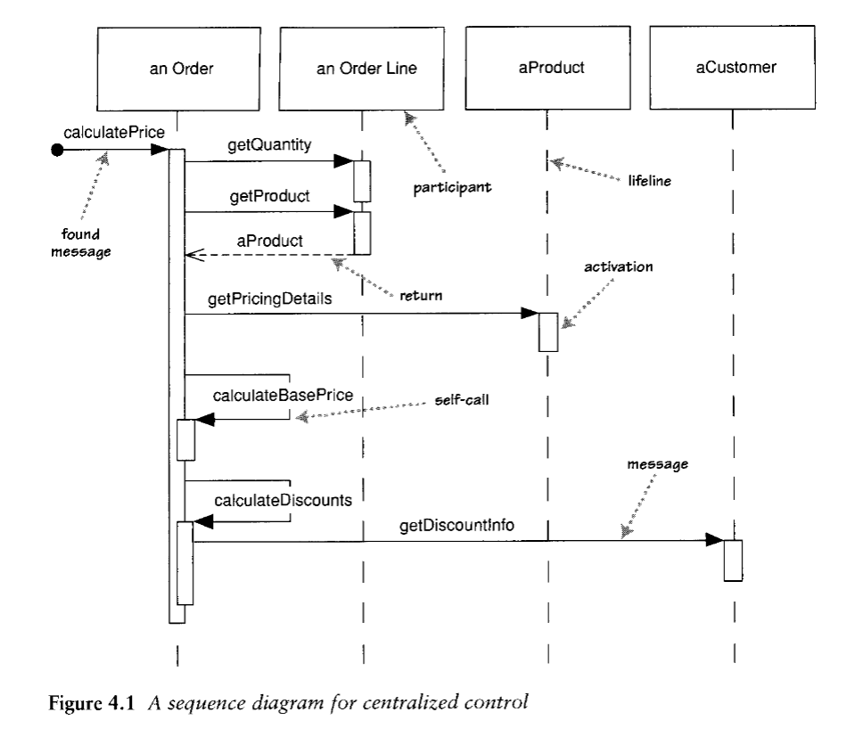

Slide 5
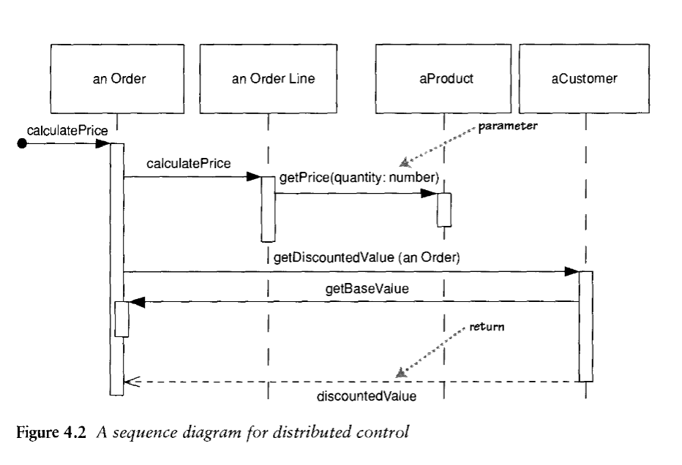

Slide 6
Pseudocode
procedure dispatch:
foreach (lineitem)
if (product.value > $10K)
careful. dispatch
else
regular.dispatch
end if
end for
if (needsConfirmation) messenger.confirm
end procedure

Slide 7
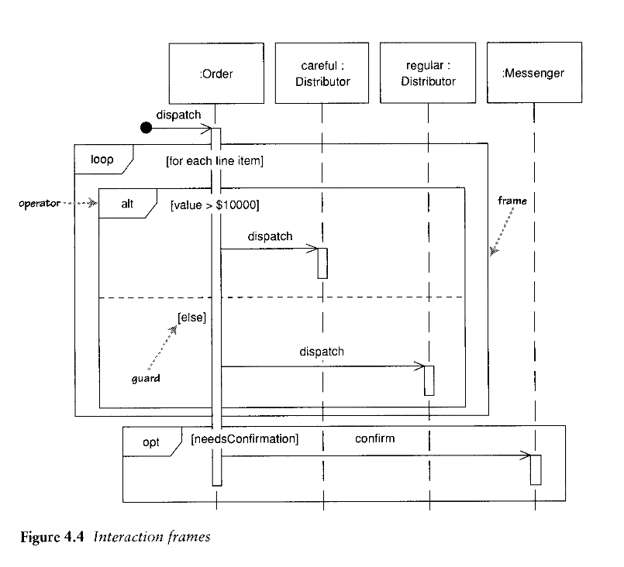

Slide 8
Emergency Aircraft Landing
The process starts when the pilot sends a request for landing to Air Traffic Controller. The controller will send new flight landing information to a scheduler and receive a number for landing sequence. Then controller will send this number to an estimator to get the estimated time of landing. After receiving the waiting time from estimator, this information is passed to the pilot from controller.
After the estimated time is over, pilot will ask for permission again to land from controller. If permission is given, pilot will ask for runway and weather information from controller and land the aircraft. If, however, permission is denied due to landing sequence congestion, pilot will ask for new waiting time from controller. If the waiting time is over 20 minutes, pilot will declare an emergency through emergency protocol. Once declaration is confirmed from the protocol management, pilot will ask for landing and weather information again and land the aircraft.

Slide 9
Emergency Aircraft Landing
The process starts when the pilot sends a request for landing to Air Traffic Controller. The controller will send new flight landing information to a scheduler and receive a number for landing sequence. Then controller will send this number to an estimator to get the estimated time of landing. After receiving the waiting time from estimator, this information is passed to the pilot from controller.
After the estimated time is over, pilot will ask for permission again to land from controller. If permission is given, pilot will ask for runway and weather information from controller and land the aircraft. If, however, permission is denied due to landing sequence congestion, pilot will ask for new waiting time from controller. If the waiting time is over 20 minutes, pilot will declare an emergency through emergency protocol. Once declaration is confirmed from the protocol management, pilot will ask for landing and weather information again and land the aircraft.

Slide 10
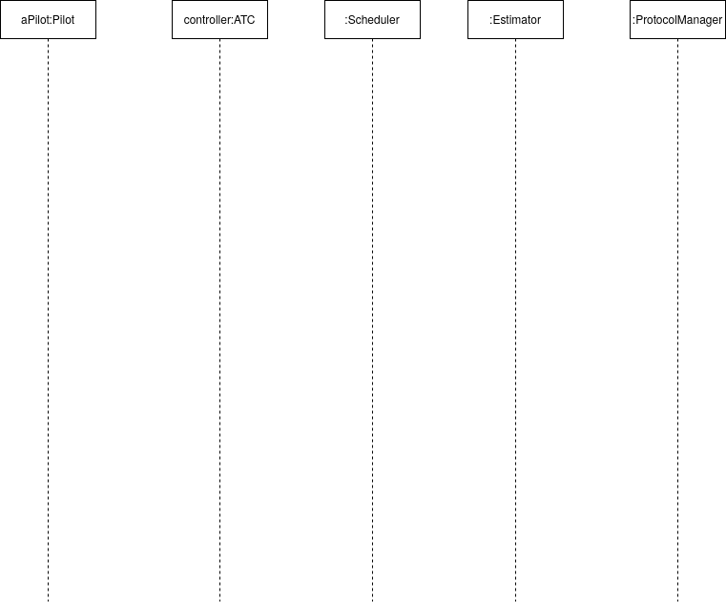

Slide 11
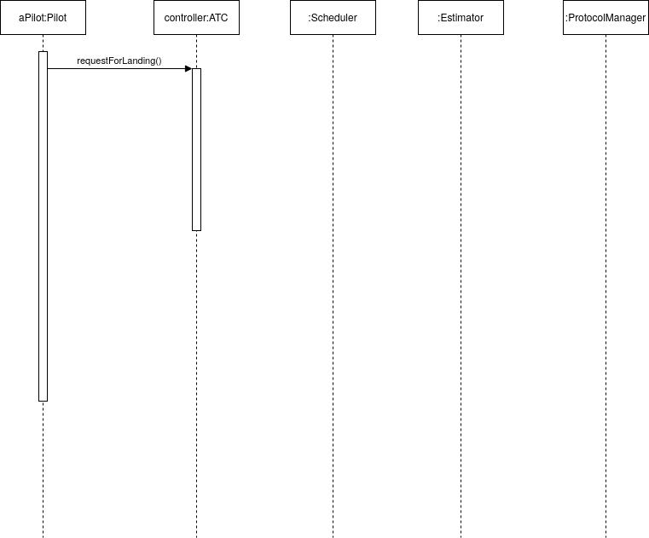

Slide 12
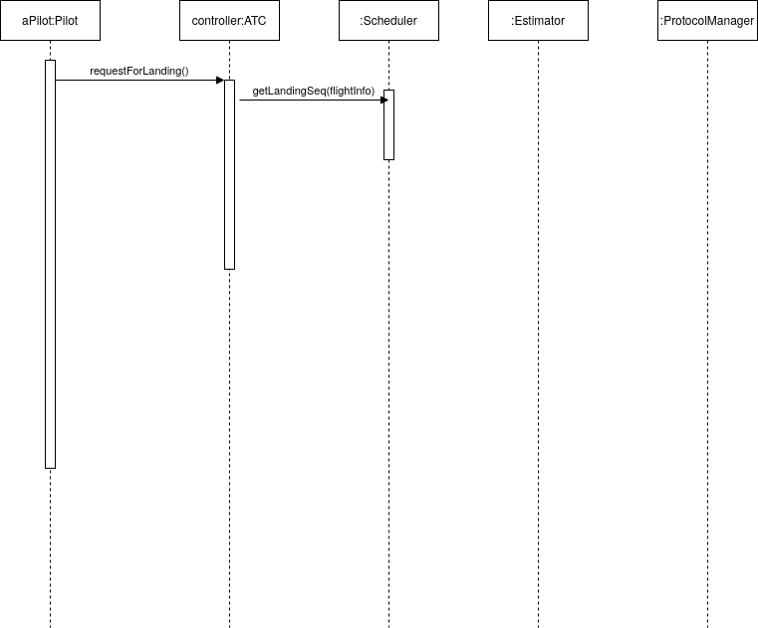

Slide 13
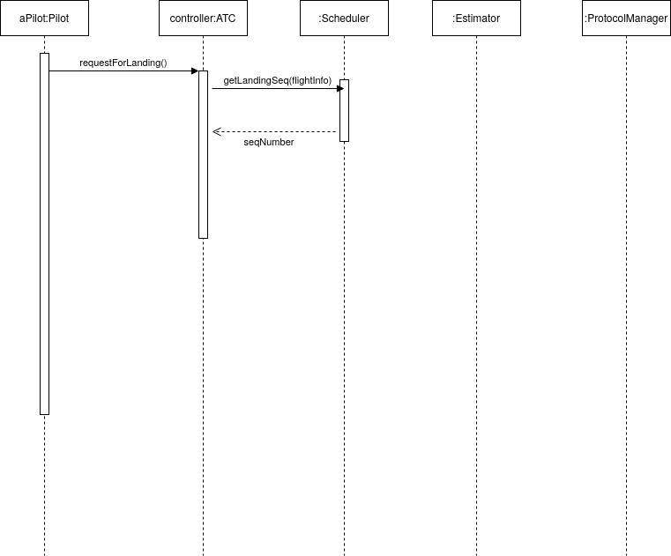

Slide 14
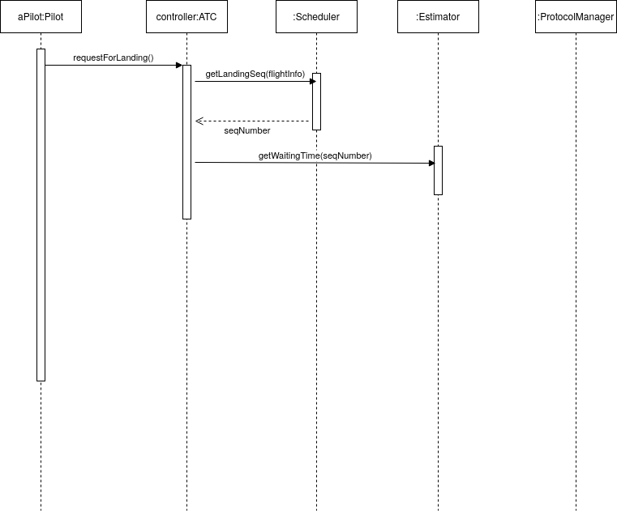

Slide 15
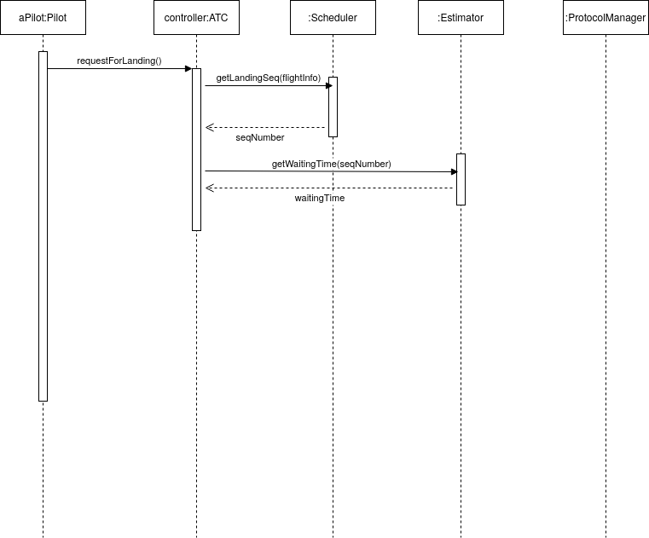

Slide 16
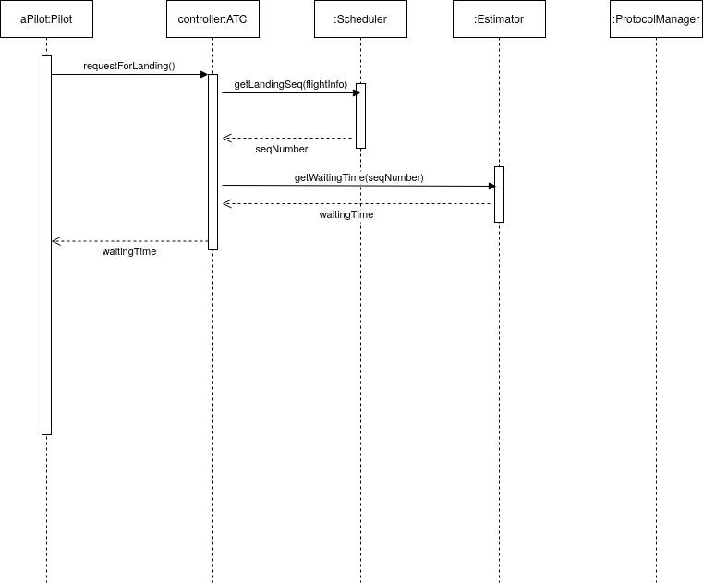

Slide 17
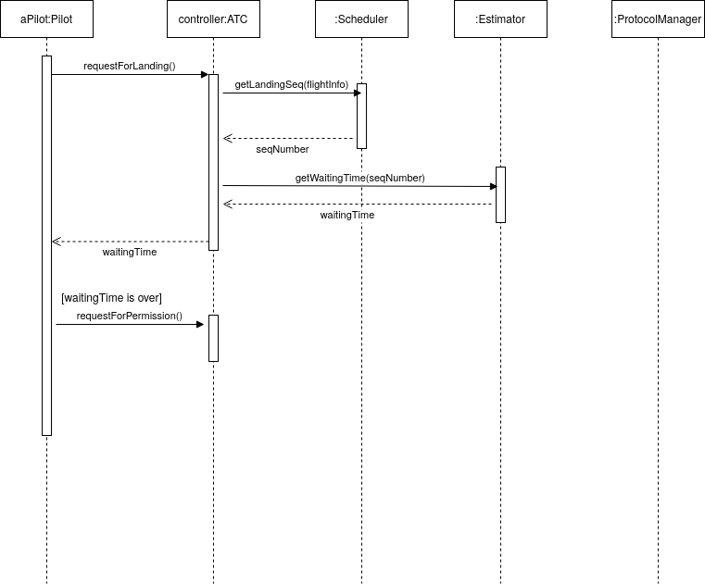

Slide 18
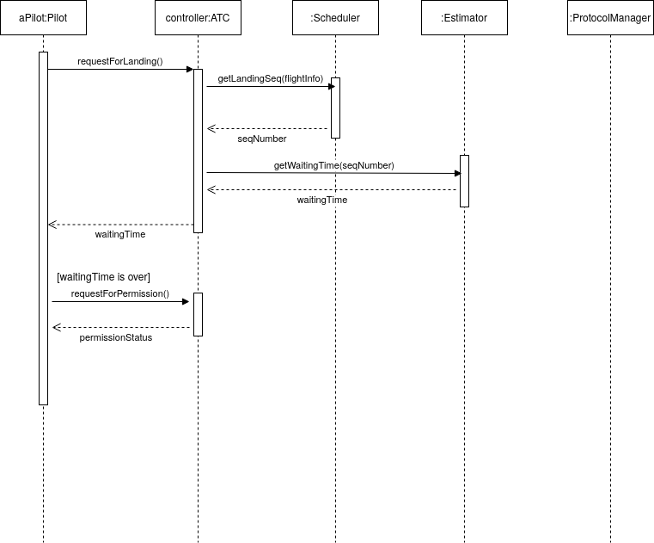

Slide 19
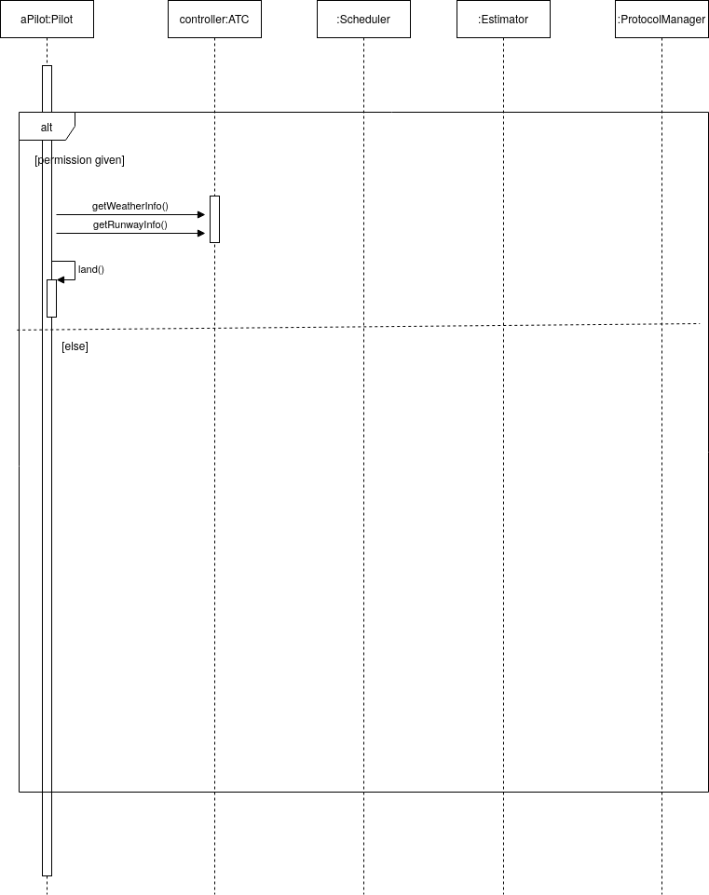

Slide 20
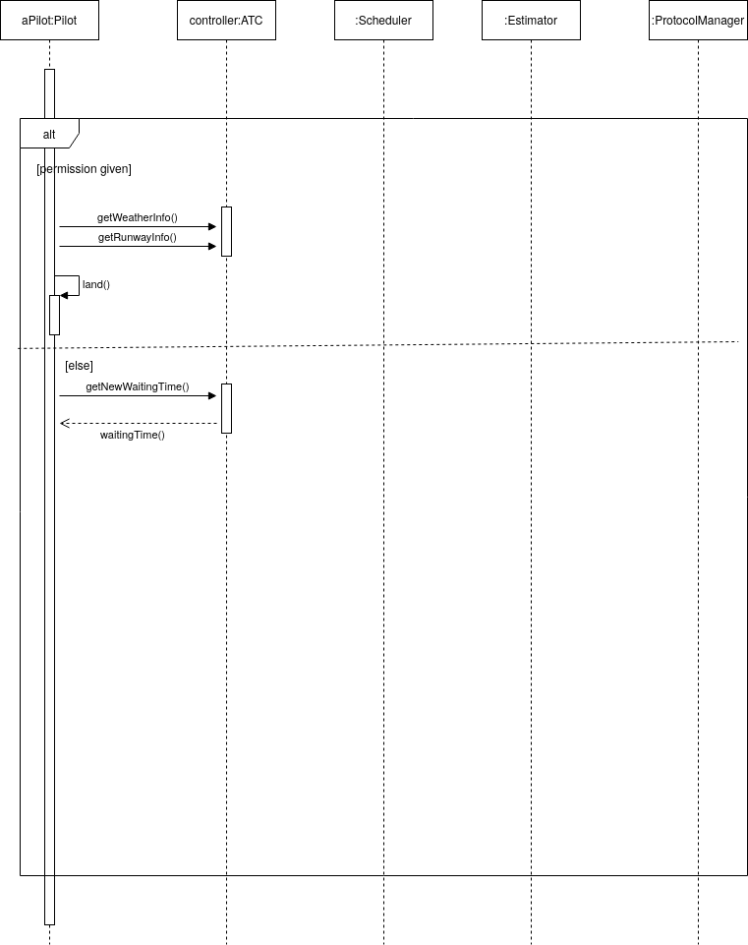

Slide 21
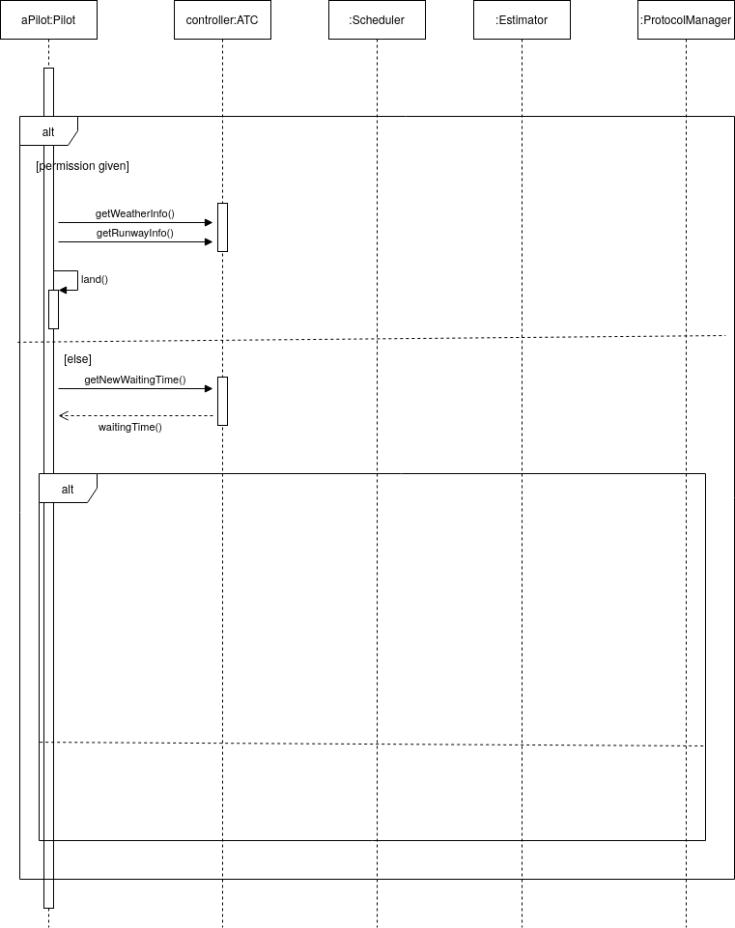

Slide 22
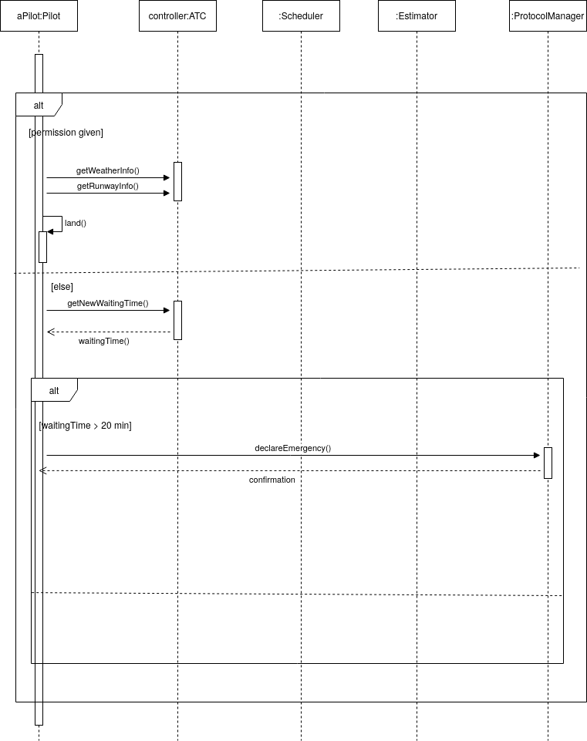

Slide 23
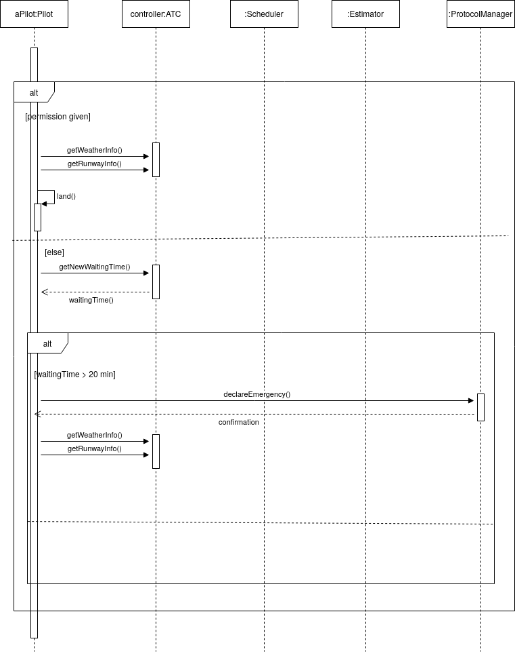

Slide 24
